Slide 1
Flight Price Prediction Project
Submitted by
Satyam Gupta

Slide 2
CONTENTS
BUSINESS PROBLEM FRAMING
HARDWARE AND SOFTWARE REQUIREMENTS
DATA SOURCES AND THEIR FORMAT
DATA PRE-PROCESSING
DATA VISUALIZATION
MODEL DEVELOPMENT AND EVALUATION
CONCLUSION

Slide 3
BUSINESS PROBLEM FRAMING
Anyone who has booked a flight ticket knows how unexpectedly the prices vary. The cheapest available ticket on a given flight gets more and less expensive over time.
This usually happens as an attempt to maximize revenue based on - 1. Time of purchase patterns (making sure last-minute purchases are expensive) 2. Keeping the flight as full as they want it (raising prices on a flight which is filling up in order to reduce sales and hold back inventory for those expensive last-minute expensive purchases) So, you have to work on a project where you collect data of flight fares with other features and work to make a model to predict fares of flights..

Slide 4
ANALYTICAL PROBLEM FRAMING
In our scrapped dataset, our target variable "Flight_price" is a continuous variable. Therefore, we will be handling this modelling problem as regression. This project is done in two parts:
1. Data Collection phase
2. Data Analysis phase
3. Model building phase

Slide 5
HARDWARE AND SOFTWARE REQUIREMENTS
For doing this project, the hardware used is a laptop with high end specification and a stable internet connection.
While coming to software part, I had used anaconda navigator and in that I have used Jupyter notebook to do my python programming and analysis. For using an CSV file, Microsoft excel is needed. In Jupyter notebook, I had used lots of python libraries to carry out this project

Slide 6
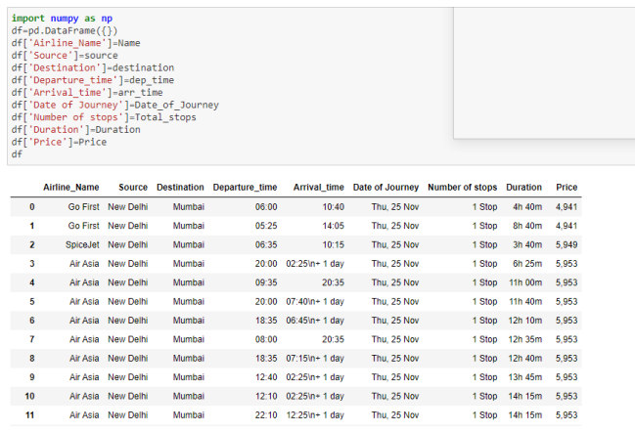
DATA SOURCES AND THEIR FORMAT
The data is collected from websites yatra.com. The data is scrapped using Web scraping technique and the framework used is Selenium.
We scrapped approx. 2500 records of the data and saved each data in a separate data frame.

Slide 7
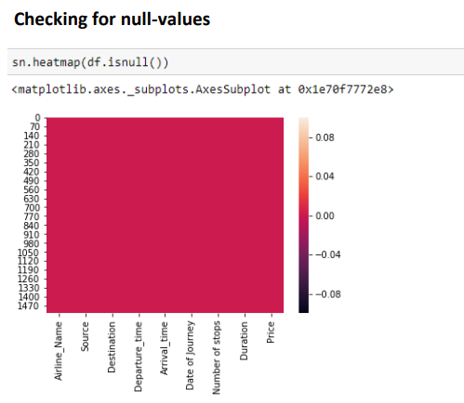
DATA PRE-PROCESSING

Slide 8
FEATURE ENGINEERING
• In this we have three columns Date of Journey, Departure time, and Arrival time to be feature engineered.
• Date of Journey is converted into date, day and month.
• Departure time is converted into hours and minutes and similarly Arrival time is converted into minutes and hours.
• Introduced new features Duration in seconds and Based upon the arrival time and departure time found out the whether flight arrived or departed in morning, afternoon and night.

Slide 9
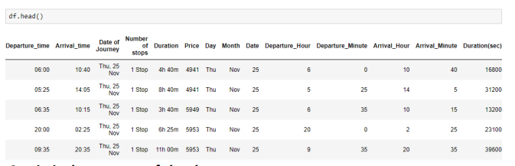

Slide 10
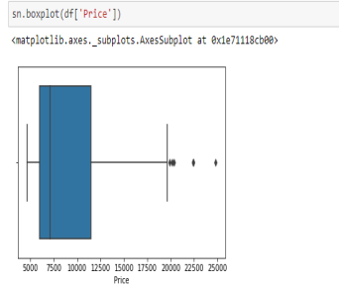
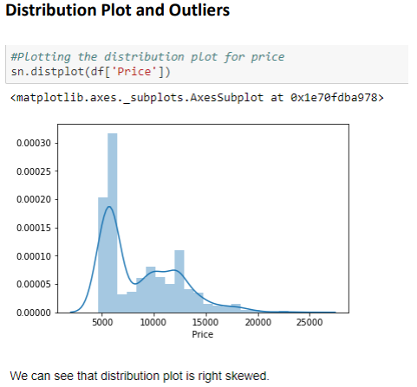
CHECKING OUTLIERS AND SKEWNESS

Slide 11
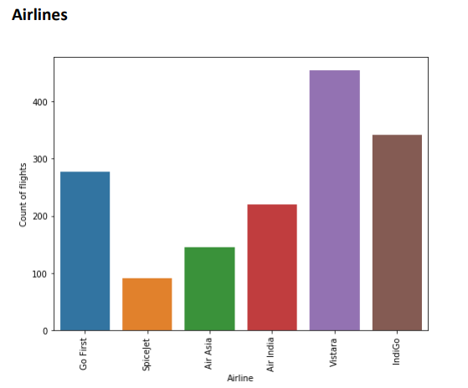
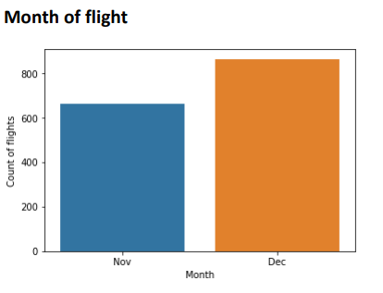
DATA VISUALISATION

Slide 12
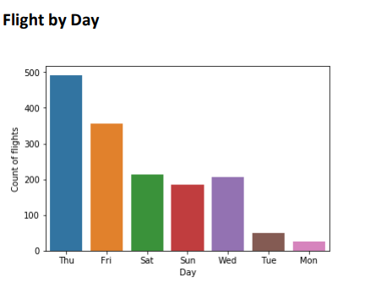
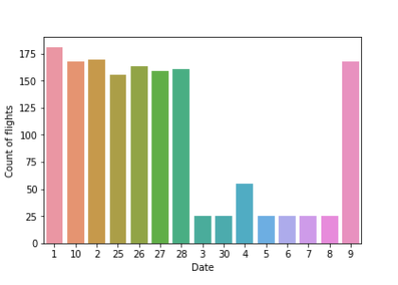

Slide 13
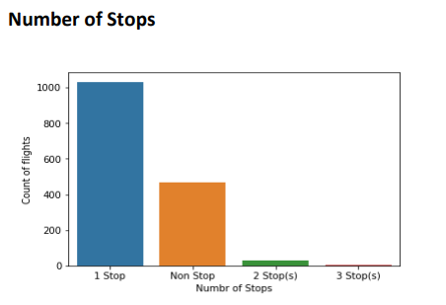
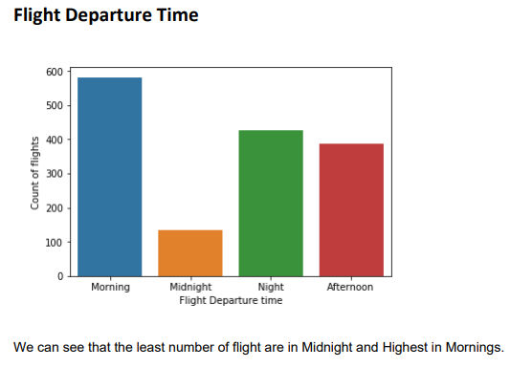

Slide 14
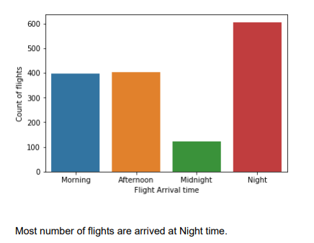
Flight Arrival Time

Slide 15
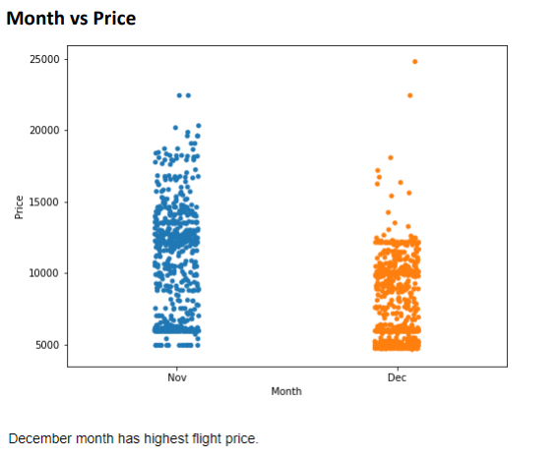
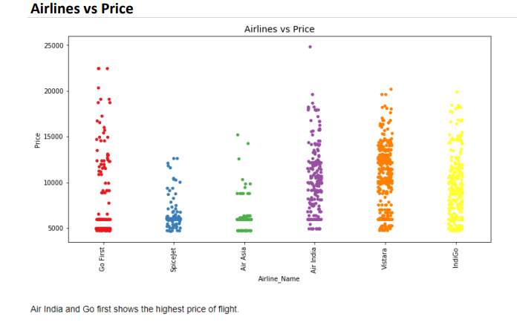

Slide 16
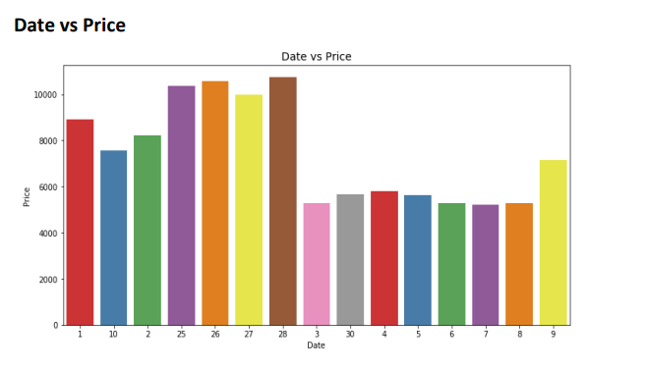

Slide 17
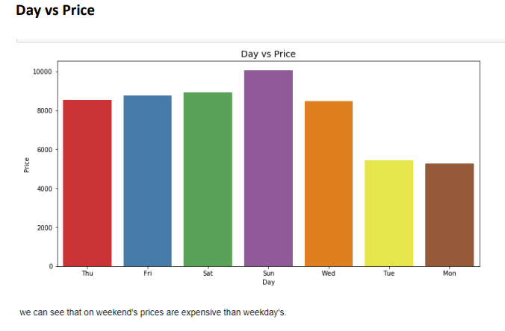

Slide 18
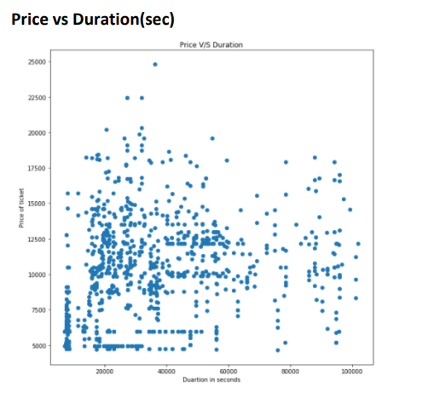
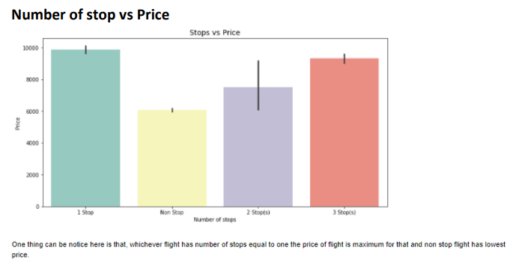

Slide 19
MODEL DEVELOPMENT AND EVALUATION
Preparing dataset for model training
Treating skewness and scaling the data
Model Building
Hyperparameter Tuning
Finalizing the model

Slide 20
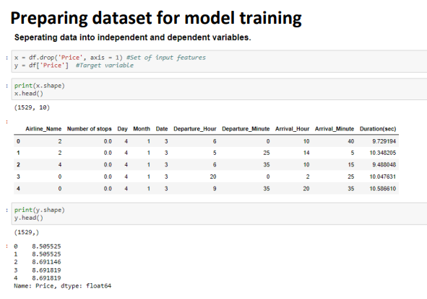

Slide 21
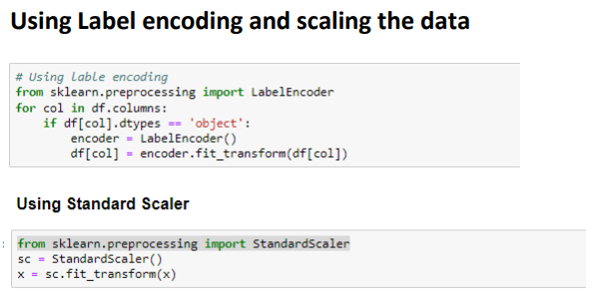

Slide 22
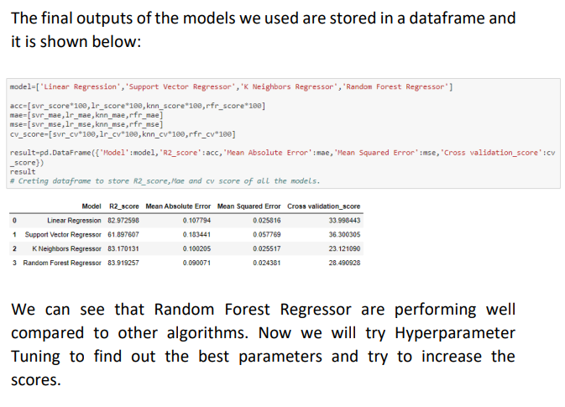

Slide 23
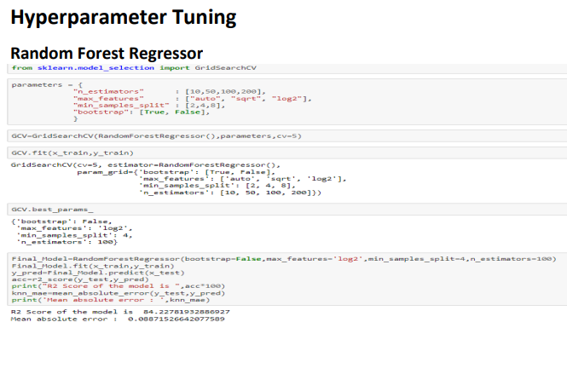

Slide 24
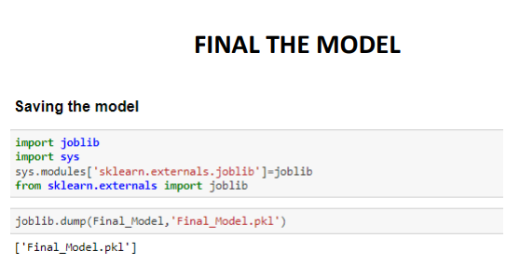
Here after trying with various model for the above dataset, I am going to choose Random forest regressor as the best model for predicting the price of the flights. Random Forest Regressor performs best with hyperparameter tuning, where accuracy increased from 83.91 to 84.22%

Slide 25
CONCLUSION
After the completion of this project, we got an insight of how to collect data, pre-processing the data, analyzing the data and building a model.
First, we collected the data flight prices from different websites like yatra and make my trip it was done by using Web scraping. The framework used for web scraping was Selenium, which has an advantage of automating our process of collecting data.
We collected almost 1500 records of data which contained the flight price and other related features.
Then, the scrapped data was combined in a single data frame and saved in a csv file so that we can open it and analyze the data.

Slide 26
We did data cleaning, data-preprocessing steps like finding and handling null values, removing words from numbers, converting object to int type, data visualization, handling skewness, etc.
After separating our train and test data, we started running different machine learning classification algorithms to find out the best performing model.
We found that RandomForest Algorithms was performing well, according to their r2_score and cross val scores.
Then, we performed Hyperparameter Tuning techniques using GridSearchCV for getting the best parameters and improving the scores. In that, RandomForestRegressor performed well and we finalised that model.
We saved or finalize the model using joblib library for further testing of the model.

Slide 27
Thank You

